Slide 1
Creating Paper Annotations - by Claire Lamman
There are many ways to annotate your papers; here is a description of how I do it with PowerPoint (version 2505).
Prepare PowerPoint file: make size the same as your paper pages (usually 8.5x11) and make as many blank slides as you have pages.
Convert your paper PDF to images: I use this site: https://pdf2png.com/
Put PDF pages into PowerPoint: Insert all of them on one slide. Select all and, under “Shape Format”, set their width to 8.5in and Align > Align Center and Align Middle. Then copy and paste them one at a time into the slides. It’s a bit tedious, but quick with Ctrl+C, Ctrl+V. Be sure not to change their positions and that the pages are in the right order.
Prepare Slides: On each slide, add a white rectangle with 30% transparency. You can copy it from the next slide. Then lock both the image and rectangle. This can be done quickly with Ctrl+A > right click - lock.
Use text boxes to annotate: Use transparent text boxes with a text color other than black and a thick font that stands out. You can also just hand-write them (see next point). I use the xkcd font which can be downloaded for free here: https://github.com/ipython/xkcd-font Bonus: create a white glow around your text for better readability. I added a textbox (with just a default Microsoft font) to the next slide that you can copy.
Draw diagrams / cartoons / annotate plots: You can add drawings in PowerPoint under ‘Draw’. I find it much easier to use this feature on a tablet that supports a PowerPoint app (like iPad). The resulting sketches can be highlighted, grouped, and moved around as you see fit.
Export as PDF

Slide 2
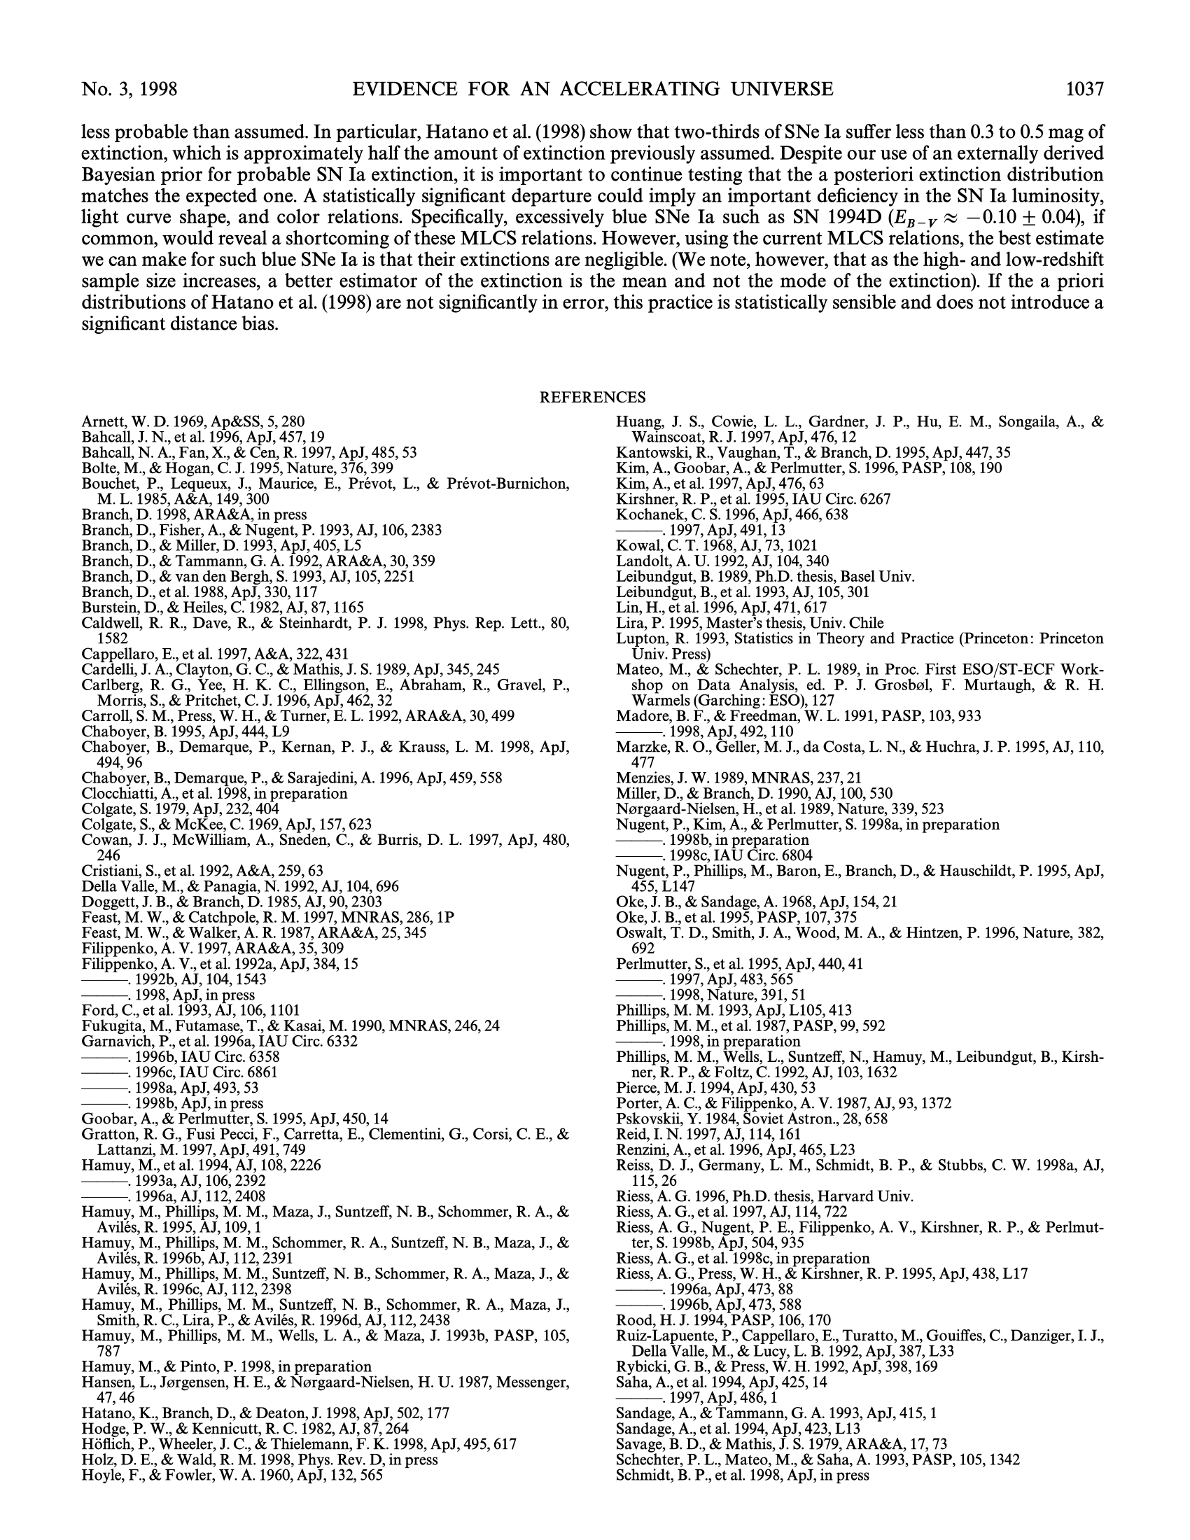

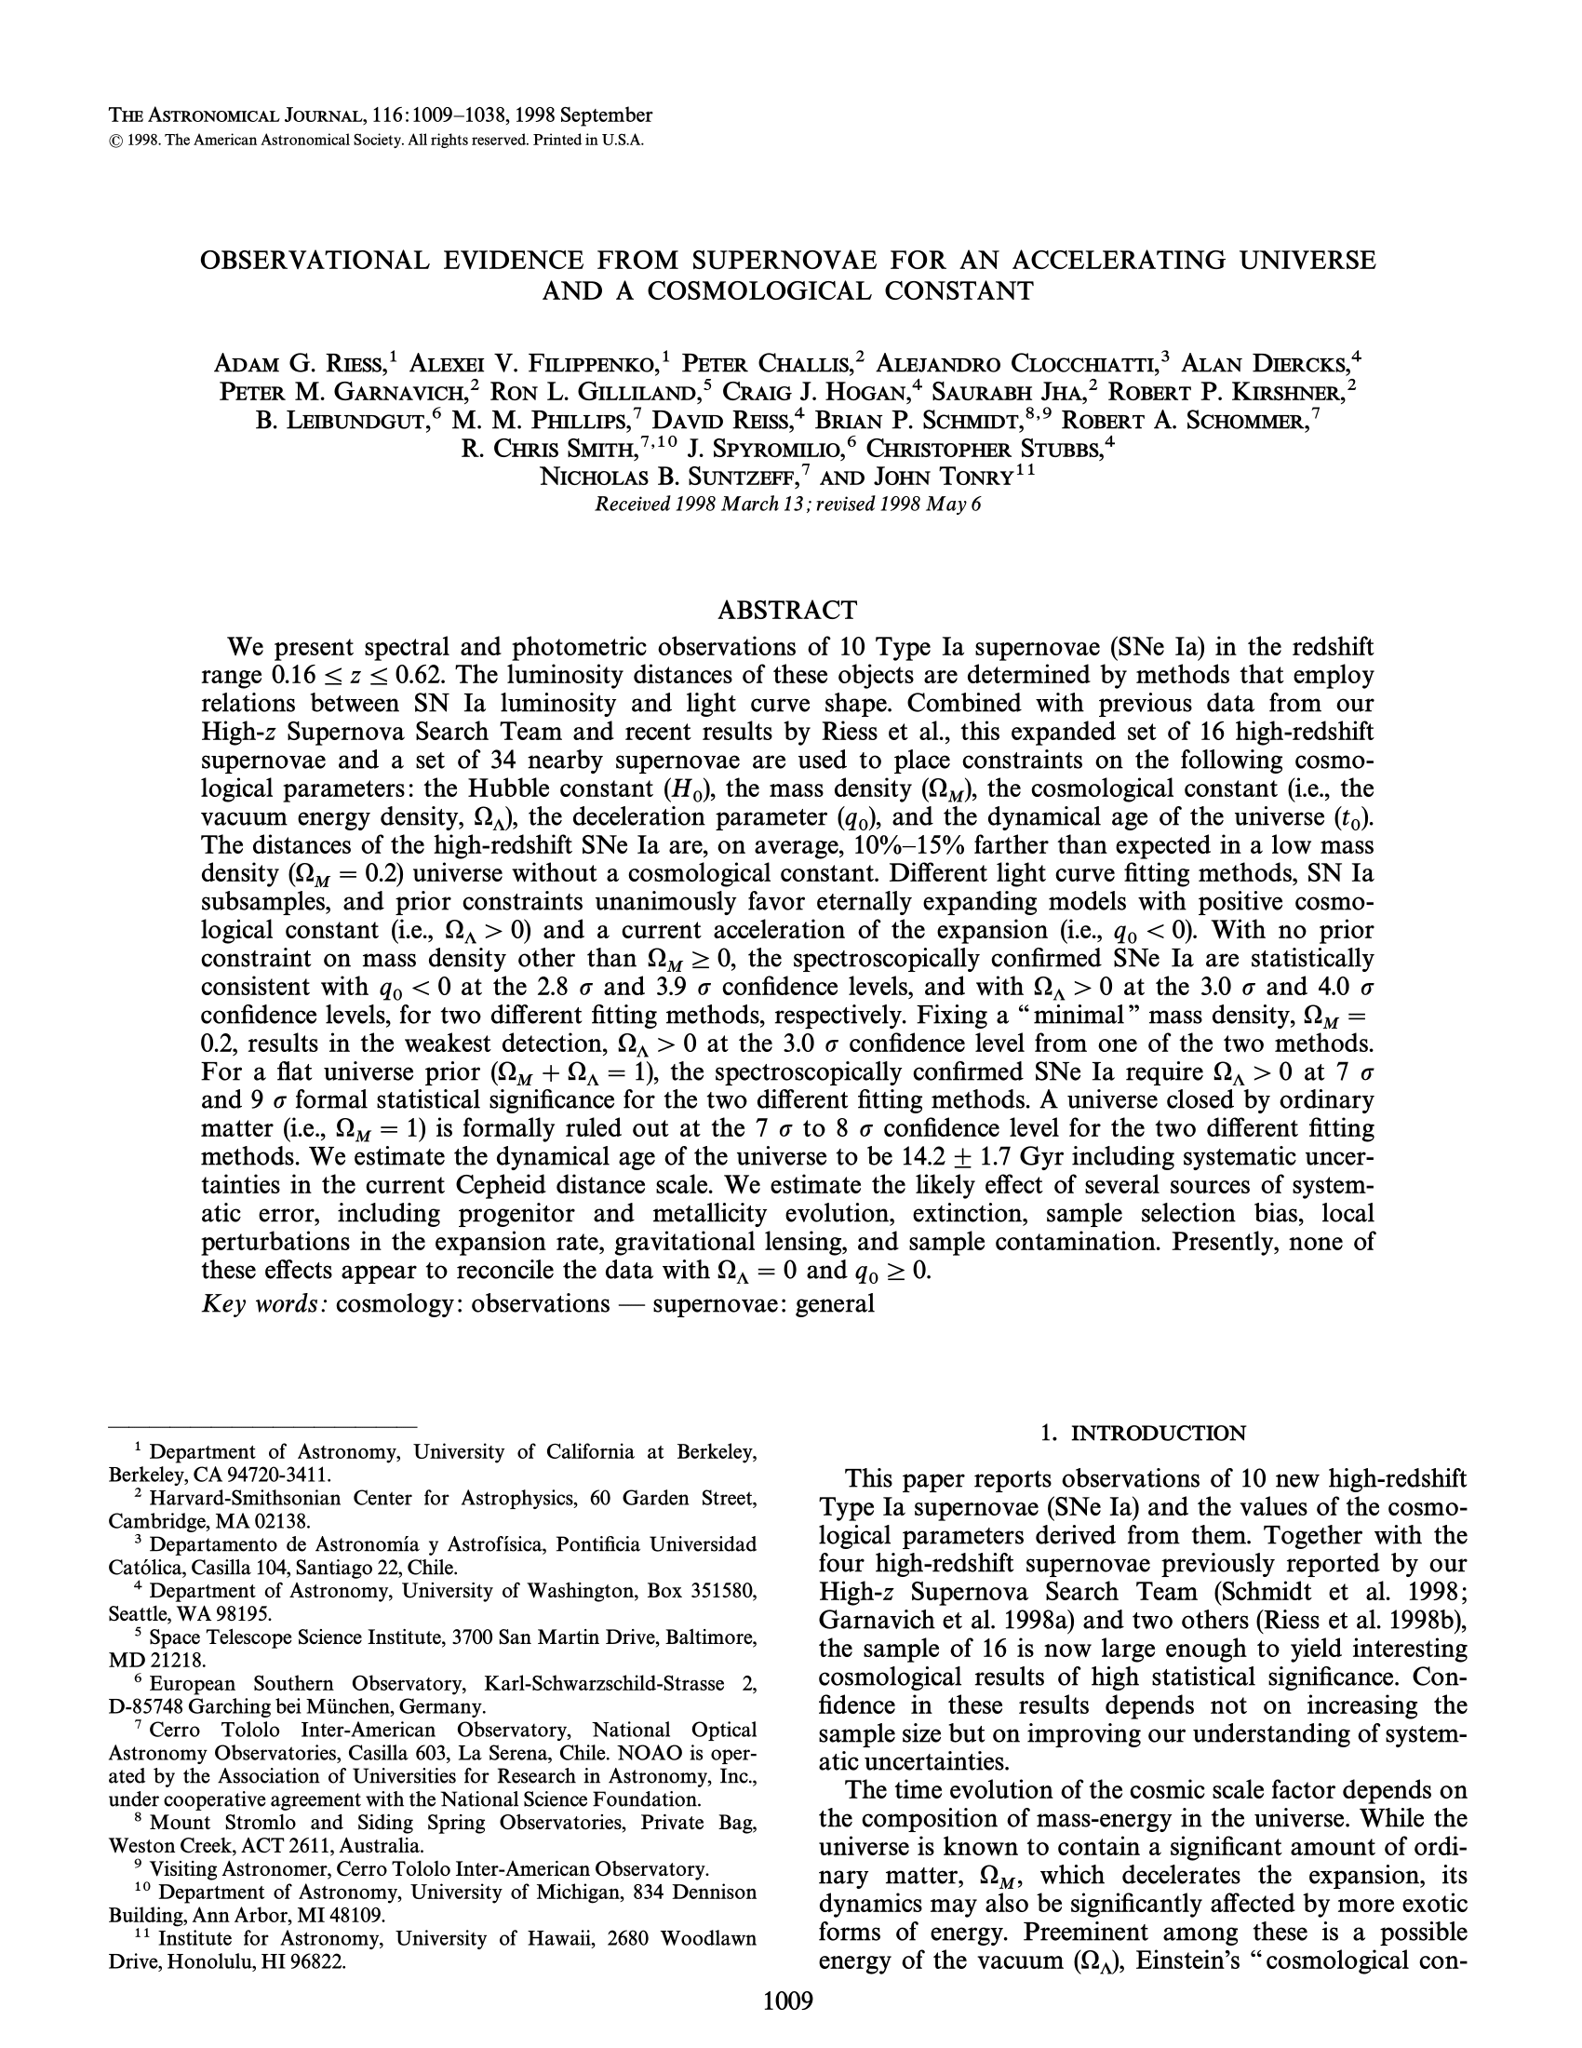

A very short, simple version of the title!
TL;DR
A very high-level summary of the already high-level summary of the original abstract! Tricky to do but a great exercise.
BACKGROUND INFO
Doodles are optional but fun. No real artistic skill required ☺ (pssst you can even copy pictures into PowerPoint and trace them!)
This text has a faint white ‘glow’ around it to help with readability. Done under Shape Format >Text Effects > Glow. Note that some PDF viewers might render this as a grey glow….

Slide 3
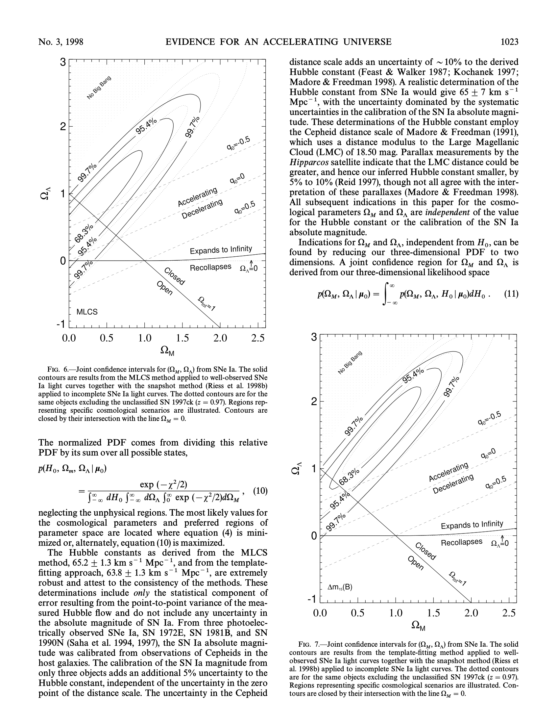


More Tips:
Use bolded fonts, underlines, and other emphasis to make certain points STAND OUT!
You don’t need to annotate every plot. Focus on ones that illustrate the main ideas.
Based on our data, the balance between matter and the cosmological constant most likely falls around here.
The expansion accelerates
Try to communicate the main idea in each section, but don’t get carried away with details. That’s what the paper is for. Keep your annotations brief and in a BIG FONT!
Amount of dark energy
The expansion decelerates
(it’s not 0!)
Amount of normal matter
Here is an example of an annotated plot. Simple arrows and circles can go a long way!

Slide 4
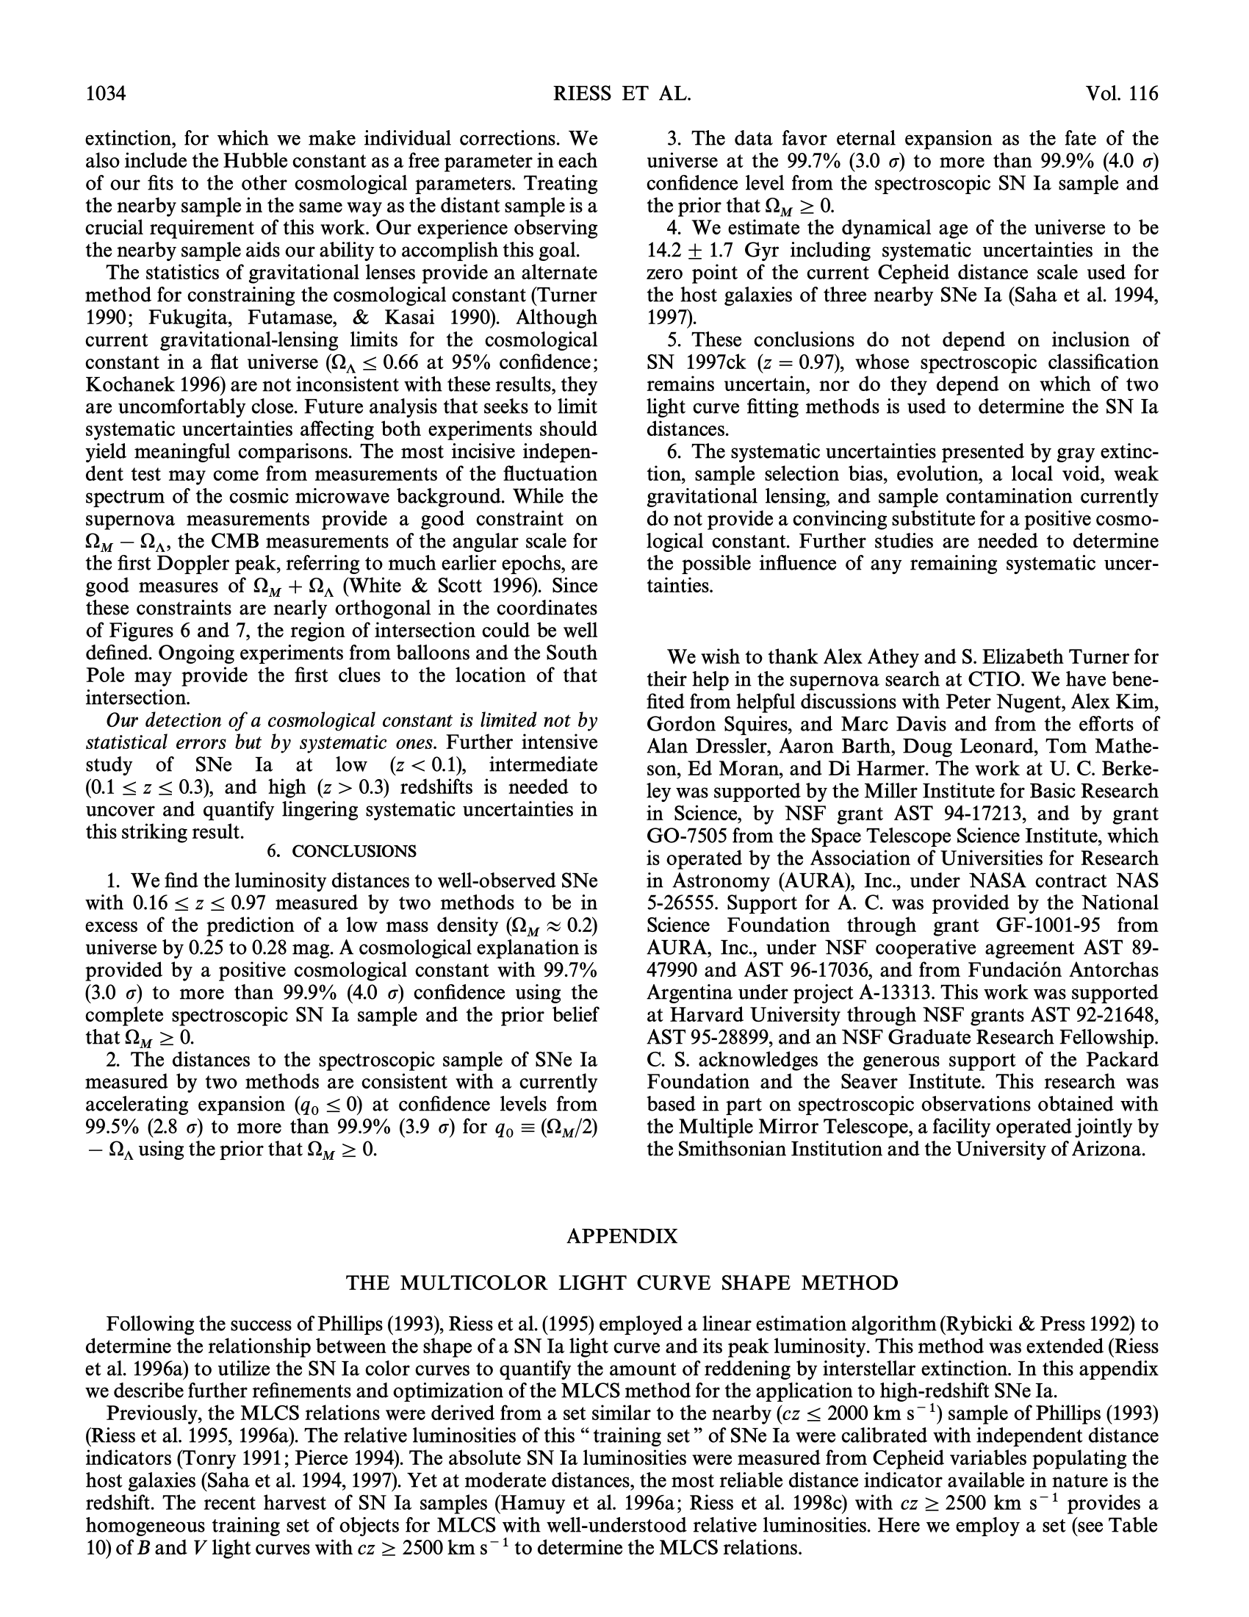


Doodles don’t need to be fancy. How would you draw an idea on a blackboard?
Looks bright
Looks faint
It can be helpful to even point out the ‘meta’ of the paper – like acknowledgments. Point out the resources and community that made this work possible!
The conclusion is a great spot to summarize the main ideas, just like in a real paper.
(you can make ‘fake’ doodled lines by setting the line style in PowerPoint to “Sketched”)
You can add a link to your original paper and any credits (i.e. other paper summaries, the XKCD font) in an end card.

